Slide 1

Historical Development of Cloud Computing & Building of Cloud Environment
M-1 T-3
Batch -09
221FJ01046
221FJ01059
221FJ01070
221FJ01071

Slide 2
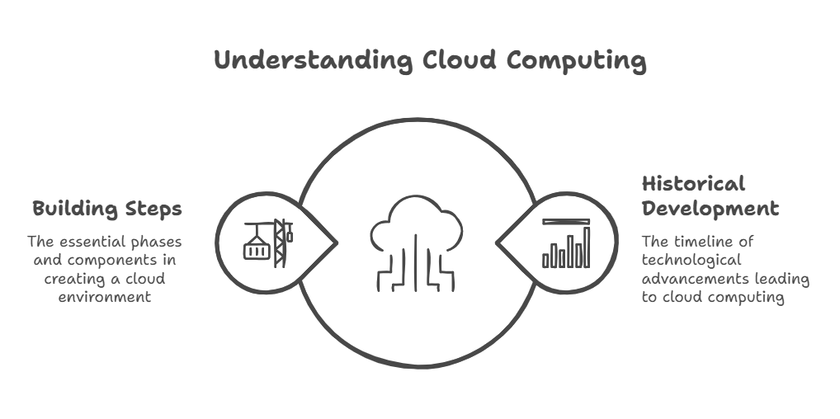
Introduction
Cloud computing revolutionized how data is stored, processed, and accessed.
Understanding its historical development helps appreciate its evolution.
This presentation also covers key steps in building a cloud environment.

Slide 3
Evolution of Cloud Computing
Cloud computing evolved from distributed computing and virtualization.
Early computing relied on mainframes (1950s-1960s).
Client-server architecture emerged in the 1970s-1980s.
Internet & Web Technologies in the 1990s enabled remote computing.
2000s: Cloud computing gained popularity with on-demand services.

Slide 4
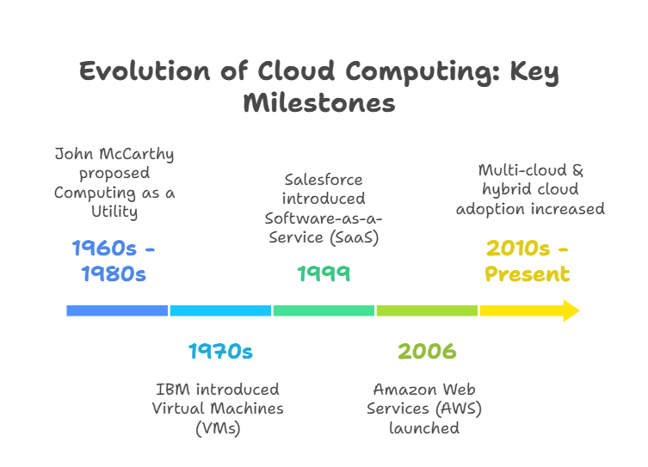

Slide 5
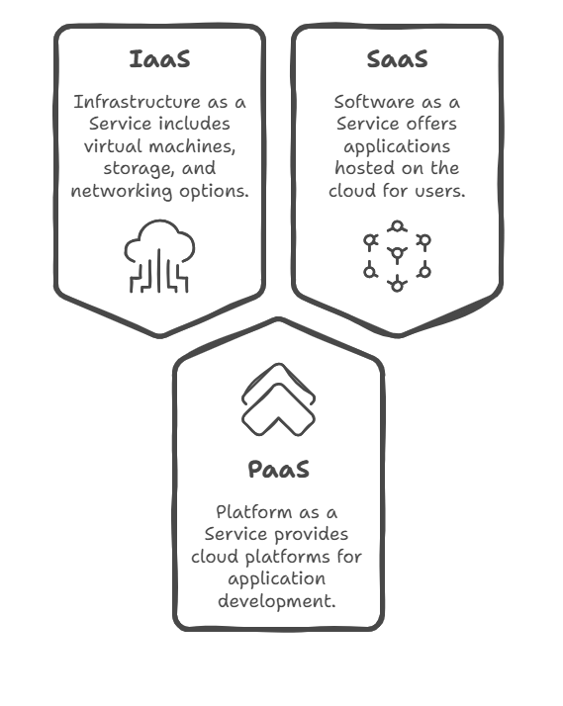
Cloud Computing Models
Infrastructure as a Service (IaaS)
Virtual machines, storage, networking (AWS EC2, Google Compute Engine).
Platform as a Service (PaaS)
Cloud platforms for app development (Google App Engine, Azure).
Software as a Service (SaaS)
Applications hosted on the cloud (Google Drive, Zoom).

Slide 6
Types of Cloud Deployment
Public Cloud – Services shared among multiple users (AWS, GCP, Azure).
Private Cloud – Exclusive cloud infrastructure for one organization.
Hybrid Cloud – Combination of public & private cloud.
Community Cloud – Shared by organizations with common needs.

Slide 7
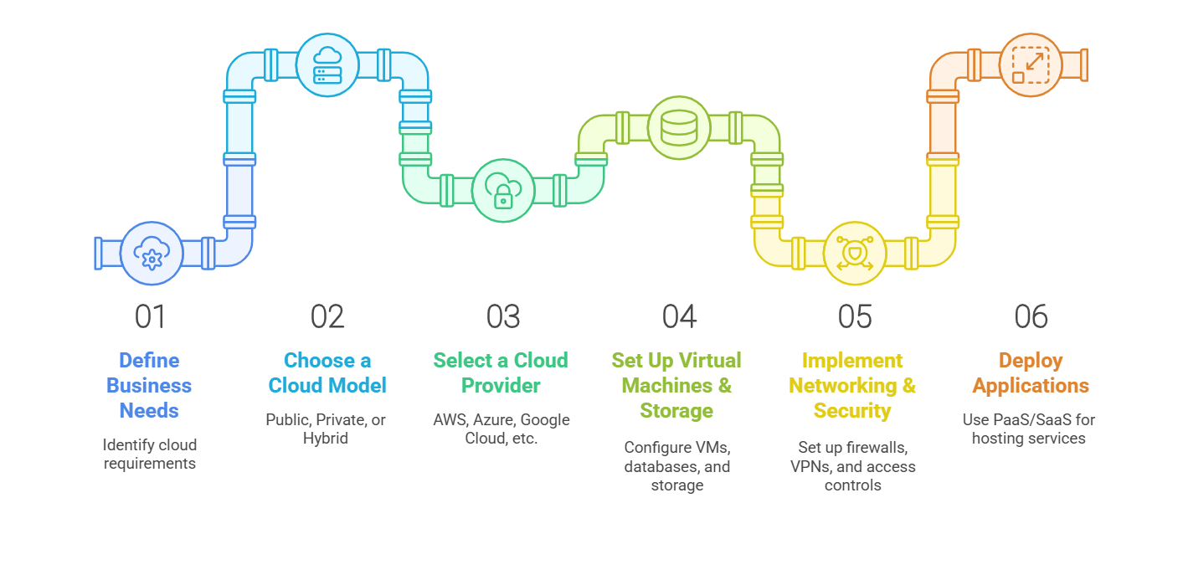
Building a Cloud Environment – Key Steps

Slide 8

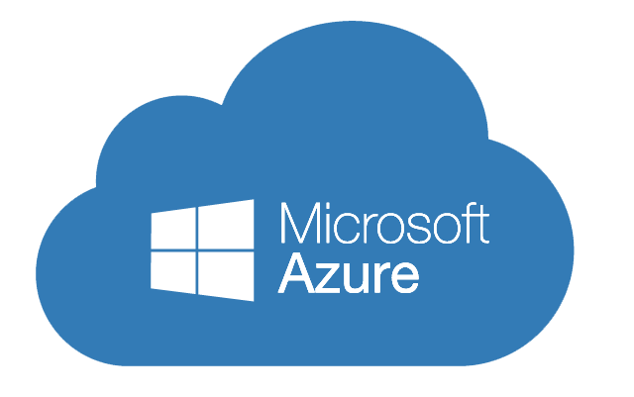

Different Cloud Computing Platforms
Amazon Web Services (AWS):
Offers a wide range of scalable cloud services.
Popular for hosting applications and creating virtual machine instances.
Microsoft Azure:
Integrated with Microsoft’s services.
Provides cloud-based VMs for various operating systems.
Google Cloud Platform (GCP):
Known for high-performance infrastructure and data analytics.
Offers cloud VMs for running different OS and applications.

Slide 9
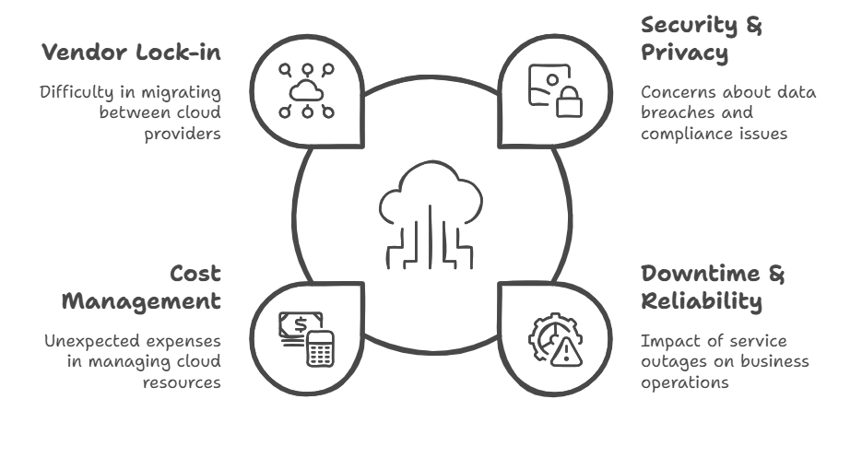
Challenges in Cloud Computing

Slide 10
Conclusion
Cloud computing has evolved from simple shared computing to AI-driven platforms.
Understanding its historical growth helps in adapting to emerging technologies.
Building a cloud environment requires planning, security, and proper implementation.

Slide 11
Thanks

